Slide 1
UML Sequence Diagrams

Slide 2
We Will Cover
What is a Sequences Diagram
UML Sequences Diagram Notation
Example of Sequences Diagram

Slide 3
What is a UML Sequence Diagrams
Sequence diagrams, commonly used by developers, model the interactions between objects in a single use case. They illustrate how the different parts of a system interact with each other to carry out a function, and the order in which the interactions occur when a particular use case is executed.
In simpler words, a sequence diagram shows different parts of a system work in a ‘sequence’ to get something done.

Slide 4
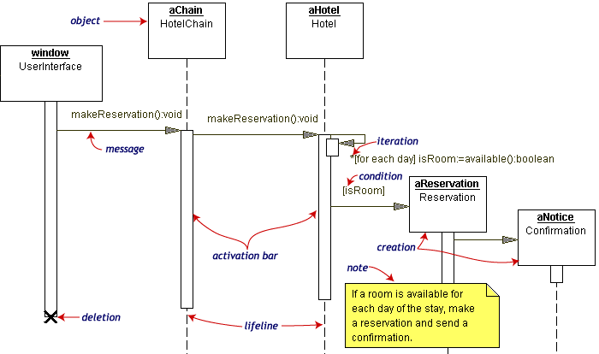
Example of Sequence Diagrams

Slide 5
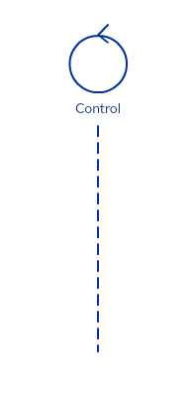
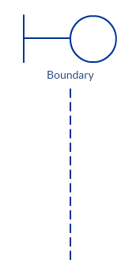
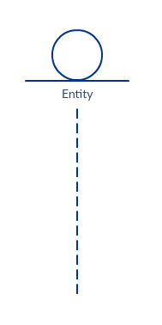
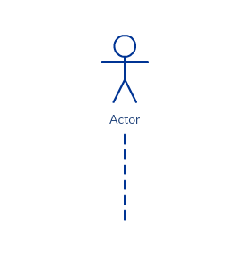
Sequence Diagram
Objects

Slide 6
Sequence Diagram Objects
Actor : is in use case diagram (who used your system)
Entity: represents system data
  example : customer service, Student service
Boundary: element indicates a system boundary/ software element in a system;
Example : user interface screens, database gateways or menus that users interact
Control: element indicates a controlling entity or boundary

Slide 7
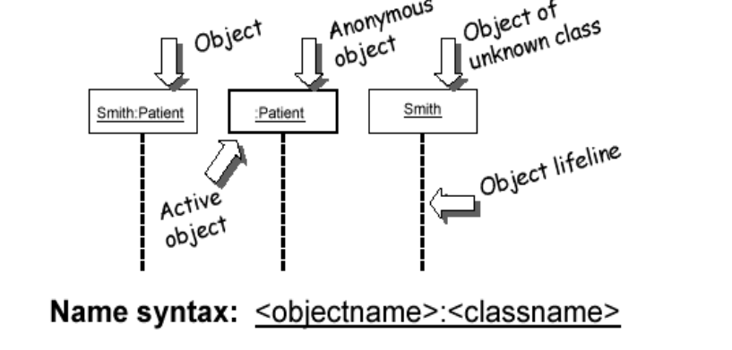
Sequence Diagram Objects

Slide 8
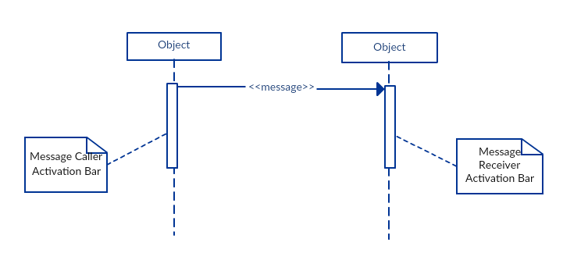
Sequence Diagram Notation
Activation Bars
Activation bar is the box placed on the lifeline. It is used to indicate that an object is active (or instantiated) during an interaction between two objects. The length of the rectangle indicates the duration of the objects staying active.

Slide 9
Sequence Diagram Notation-Messages
The message arrows represent the communications between two objects in a sequence diagram. It goes from the lifeline of one object to that of another object
  Synchronous message where the sending object suspends action and waits for the response to the message
  Asynchronous message where the sending object continues with its operations without waiting for the response
  A return of control from the synchronous message
  A creation of a new entity
(filled head)
(open head)

Slide 10
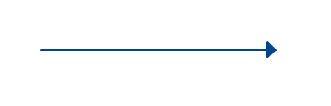
Sequence Diagram Notation
Message Arrows
A synchronous message is used when the sender waits for the receiver to process the message and return before carrying on with another message. The arrowhead used to indicate this type of message is a solid one, like the one below.

Slide 11
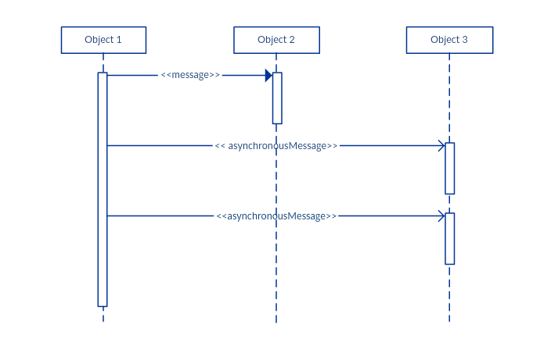
Sequence Diagram Notation
Asynchronous message
synchronous message is used when the message caller does not wait for the receiver to process the message and return before sending other messages to other objects within the system
Notes:
le, a synchronous message is used when the sender waits for the receiver to process the message and return before carrying on with another message. The arrowhead used to indicate this type of message is a solid one, like the one below.

Slide 12
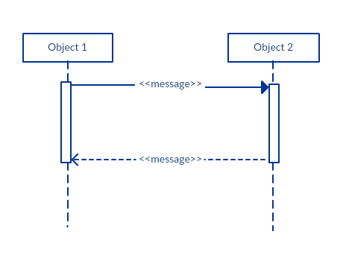
Sequence Diagram Notation
Return message
A return message is used to indicate that the message receiver is done processing the message and is returning control over to the message caller. Return messages are optional notation pieces, for an activation bar that is triggered by a synchronous message always implies a return message.
Notes:
le, a synchronous message is used when the sender waits for the receiver to process the message and return before carrying on with another message. The arrowhead used to indicate this type of message is a solid one, like the one below.

Slide 13
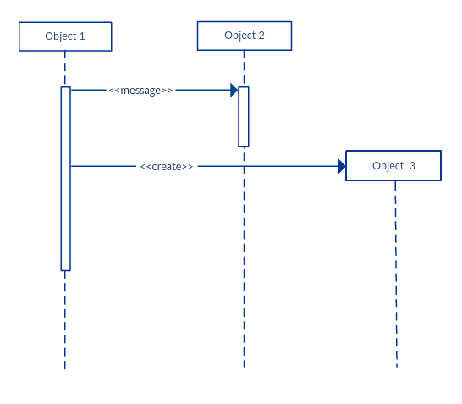
Sequence Diagram Notation
Creation message
Objects do not necessarily live for the entire duration of the sequence of events. Objects or participants can be created according to the message that is being sent.
The dropped participant box notation can be used when you need to show that the particular participant did not exist until the create call was sent. If the created participant does something immediately after its creation, you should add an activation box right below the participant box.
le, a synchronous message is used when the sender waits for the receiver to process the message and return before carrying on with another message. The arrowhead used to indicate this type of message is a solid one, like the one below.

Slide 14
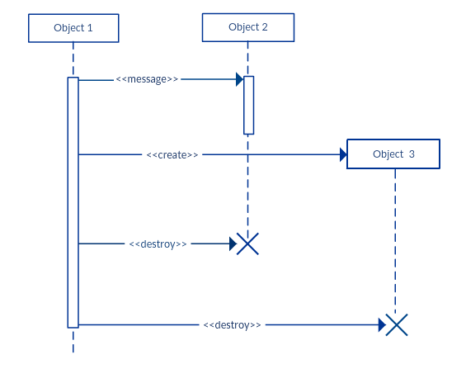
Sequence Diagram Notation
Destruction message
.
Likewise, participants when no longer needed can also be deleted from a sequence diagram. This is done by adding an ‘X’ at the end of the lifeline of the said participant.
le, a synchronous message is used when the sender waits for the receiver to process the message and return before carrying on with another message. The arrowhead used to indicate this type of message is a solid one, like the one below.

Slide 15
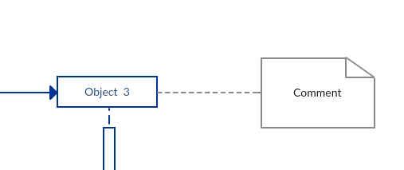
Sequence Diagram Notation
Comment
UML diagrams generally permit the annotation of comments in all UML diagram types. The comment object is a rectangle with a folded-over corner as shown below. The comment can be linked to the related object with a dashed line.

Slide 16
Sequence Diagram Notation
Comment
UML diagrams generally permit the annotation of comments in all UML diagram types. The comment object is a rectangle with a folded-over corner as shown below. The comment can be linked to the related object with a dashed line.

Slide 17
Interaction Fragments
Sequence diagram depicts the interactions among the entities. The natural flow of “control” in the diagram is sequential from top to bottom and follows the direction of the message arrows. The natural sequential control can be “broadened” with “Interaction Fragments”:
  Optional Fragment ( “if –then” )
  Alternative Fragment ( “if-then-else-if - - -” or “case” )
  Break Fragment ( “break” )
  Loop Fragment ( iterations or “loop” )
Note that these fragments are like the control structures that exist in
a high level programming language.

Slide 18
Depicting a Fragment Graphically
seq-dia sample
client
order
inventory
Interaction
Fragment
create
operator
op1
Interaction
Fragment
Operation
Name:
(e.g. loop)
Interaction Fragment
Operand
Locate item

Slide 19
Depicting an “Optional” Fragment
sd sample
client
order
inventory
Interaction
Fragment
Interaction
Fragment
Operation
Name:
(optional)
optional
[new_cust]
cr_custinfo()
Interaction
Fragment
Condition
(guard)
create_order
locate_item()
Interaction Fragment
Operand
This Optional Fragment has only 1 operand and guard in brackets. A guard
is a Boolean expression. The Optional Fragment is performed if the guard is true at
that point of the interaction. It is like the “if” structure of programming language

Slide 20
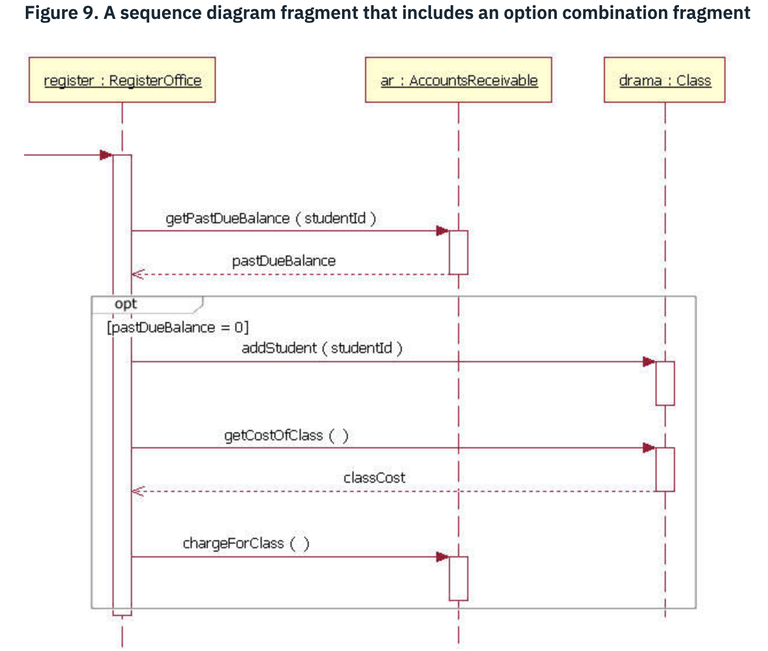
Example of “opt”
05-Use-Cases

Slide 21
Depicting an “Alternative” Fragment
sd sample
client
order
inventory
Interaction
Fragment
Interaction
Fragment
Operation
Name:
(Alternative)
alt
[new_cust=yes]
cr_custinfo()
Interaction
Fragment
guard
[new_cust= no]
get_custinfo()
Cr_order( )
Interaction Fragment
Operands
The Alternative Fragment has multiple mutually exclusive guards in brackets. The
operand associated with the true guard is executed. This structure is like the “CASE”
or “if-then-else-if” constructs of the programming language

Slide 22
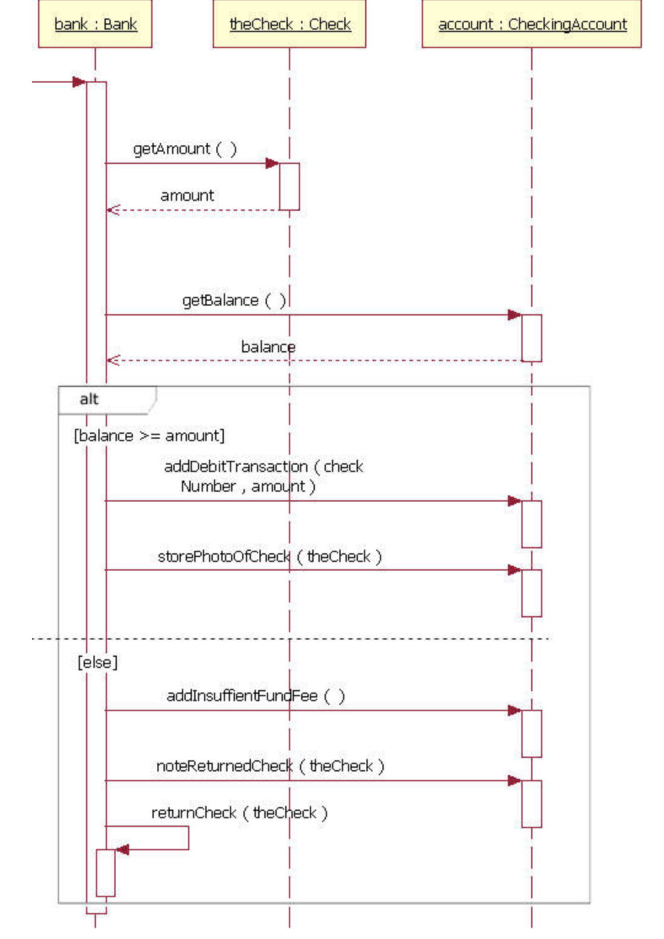
Example of “alt”

Slide 23
Break Fragment
sd sample
client
order
inventory
Interaction
Fragment
Operation
Name:
(Break)
break
[ ! good_status]
error_msg( )
alt
[new_cust=yes]
cr_custinfo()
The guard
expression of
NOT good_status
[new_cust= no]
get_custinfo()
Cr_order( )
The Break Fragment has a single operand which is processed if the guard is “true,”
and the rest of the processing in the diagram is not performed. It is like the “break”
construct in programming language.

Slide 24
Loop Fragment
sd sample
order
inventory
n_it = check_items()
Interaction
Fragment
Operation
Name:
Loop (min,max)
create
checking for
more items
iterator
more = has_item (n_it)
Loop
[more]
Process_item()
The guard
expression of
[ more]
more = has_item(n_it)
** The Loop Fragment is expressed as Loop(min,max). The loop is performed at
least min times and at most max times. If neither min or max is specified, then min=0
and max is unlimited. If the loop is performed min times but less than max, then it is
performed again as long as the guard is true. The default value of guard is true.

Slide 25
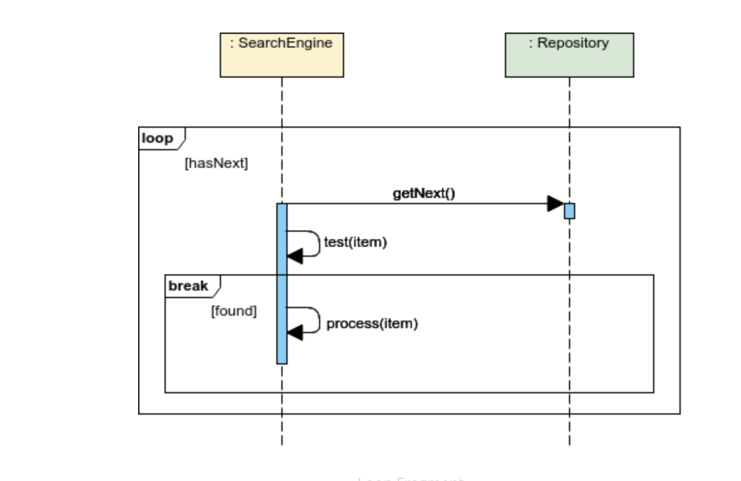
Loop and Break fragments

Slide 26
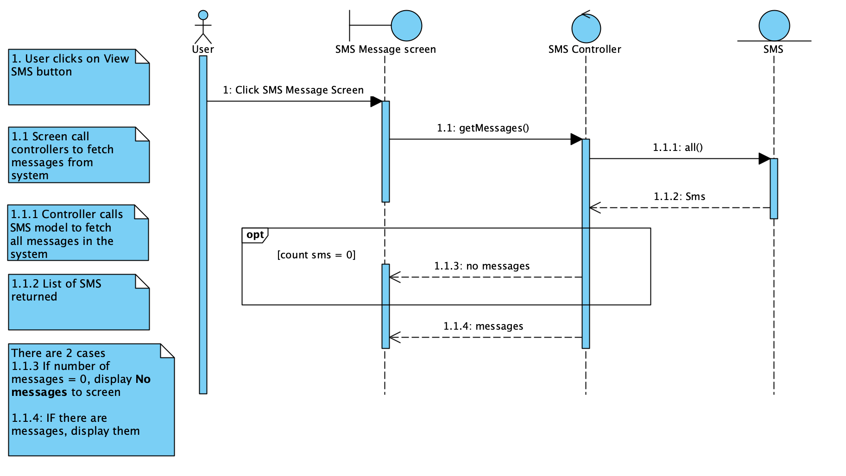
Example of Sequence Diagram

Slide 27
Code translation
class SMSController
{
private SMS sms;
//inject model in controller
public SMSController(SMS sms)
{
this.sms = sms;
}
public List<SMS> getMessages()
{
// step 1.1.1
List<SMS> sms = this.sms.all();
//alt fragment used
if (sms.size() == 0) {
return "NO message found";
}
return sms;
}
}

